Slide 1
Deadlocks
Unit - III :
Deadlock: Definition, Necessary and sufficient conditions for Deadlock, Deadlock Prevention, Deadlock Avoidance, Banker's algorithm, Deadlock detection and Recovery.

Slide 2
Chapter Objectives
What causes deadlock
Methods for preventing, avoiding, or detecting deadlocks in a computer system

Slide 3
System Model
Resource types R₁, R₂, . . ., R_{m} CPU cycles, memory space, I/O devices
Each resource type R_{i} has 1 or more instances
While accessing each process must follow following sequence:
request ................. Use system call
Use
Release------------- use system call
For the resource that is not managed by system call, process uses semaphore or locks
Resource allocation depends on requirement and availability.
Allocation information is maintained by the system

Slide 4

Deadlock
The set of processes are said to be in deadlock state, if each process in a set is holding some resource and is waiting for the resource that is held by another process in a set.
P1(R1)
P2(R2)
P1(R5)
P3(R3)
P4(R4)

Slide 5
System Model
A deadlock consists of a set of blocked processes, each holding a resource and waiting to acquire a resource held by another process in the set
Deadlock may involve different resource type
Proc1: Proc2:
request printer request plotter
request plotter request printer
Proc1
Printer
Proc2
Plotter

Slide 6
Deadlock in semaphore
Semaphores A and B, initialized to 1
P₀ P₁
wait (A); wait(B)‏
wait (B); wait(A)‏

Slide 7
Bridge Crossing Example
Multiprogramming system:
Multiple processes (vehicles)
Scanty resource (one_lane bridge)
Traffic only in one direction
If a deadlock occurs, it can be resolved if one car backs up (preempt resources and rollback)‏
Several cars may have to be backed up if a deadlock occurs
Starvation is possible

Slide 8
Problems due to Deadlock
Processes never complete their execution
Resources are tied up, preventing other processes from starting

Slide 9
Deadlock Characterization
Deadlock can arise if four conditions hold simultaneously.
Mutual exclusion: At least one resource must be held in a nonsharable mode; that is, only one process at a time can use the resource. If another process requests that resource, the requesting process must be delayed until the resource has been released.
Hold and wait: a process holding at least one resource is waiting to acquire additional resources held by other processes
No preemption: Resources cannot be preempted; that is a resource can be released only voluntarily by the process holding it after that process has completed its task
Circular wait: A set { P0 , Pl, ... , P11 } of waiting processes must exist such that Po is waiting for a resource held by P1, P1 is waiting for a resource held by P2, ... , Pn-1 is waiting for a resource held by Pn and Pn is waiting for a resource held by Po

Slide 10
Resource-Allocation Graph
Deadlocks can be described more precisely in terms of a directed graph called a system resource allocation graph. This graph consists of a set of vertices V and a set of edges E.
V is partitioned into two types:
P = {P₁, P₂, …, P_{n}}, the set consisting of all the processes in the system
R = {R₁, R₂, …, R_{m}}, the set consisting of all resource types in the system
request edge – directed edge P_{i} → R_{j}
assignment edge – directed edge R_{j} → P_{i}

Slide 11
Resource-Allocation Graph (Cont.)
Process
Resource Type with 4 instances
P_{i} requests instance of resource type R_{j}
P_{i} is holding an instance of R_{j}
P_{i}
R_{j}
P_{i}
R_{j}

Slide 12


Example of a Resource Allocation Graph
Request
Edge
Allocation
Edge
Request
Allocation

Slide 13
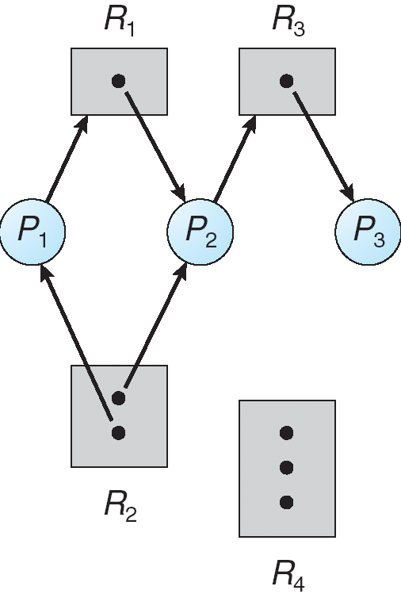
System Resource-Allocation Graph (contd..)
request
Assign
release

Slide 14
System Resource-Allocation Graph (contd..)
Current status
P={P1,P2,P3}
R={R1,R2,R3,R4}
E={P1→R1,P2→R3,R1→P2,R2→P2,R2→P1,R3→P3}
Resource instances:
One instance of resource type R1
Two instances of resource type R2
One instance of resource type R3
Three instances of resource type R4
Process states:
Process P1 is holding an instance of resource type R2 and is waiting for an instance of resource type R1 .
Process P2 is holding an instance of R1 and an instance of R2 and is waiting for an instance of R3.
Process P3 is holding an instance of R3 .
If cycle then deadlock
Else no deadlock

Slide 15
Resource-allocation graph.
Given the definition of a resource-allocation graph, if the graph contains no cycles, then no process in the system is deadlocked.
If the graph does contain a cycle, then a deadlock may exist.
If each resource type has exactly one instance, then a cycle implies that a deadlock has occurred.
If the cycle involves only a set of resource types, each of which has only a single instance, then a deadlock has occurred.
Each process involved in the cycle is deadlocked.
In this case, a cycle in the graph is both a necessary and a sufficient condition for the existence of deadlock.
If each resource type has several instances, then a cycle does not necessarily imply that a deadlock has occurred.
In this case, a cycle in the graph is a necessary but not a sufficient condition for the existence of deadlock.
To illustrate this concept, we return to the resource-allocation graph depicted in Figure 7.2.

Slide 16
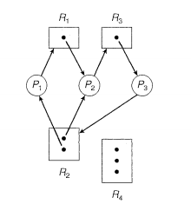
Resource Allocation Graph With A Deadlock
Before P₃ requested an instance of R₂
After P₃ requested an instance of R₂
Two cycles:
Figure 7.3 Resource-allocation graph with a deadlock.

Slide 17
Resource Allocation Graph With A Deadlock
Suppose that process P3 requests an instance of resource type R2. Since no resource instance is currently available, a request edge P3 → R2 is added to the graph (Figure 7.3). At this point, two minimal cycles exist in the system:
P1→R1→P2→R3→P3→R2→P1
P2→R3→P3→R2→P2
Processes P1, P2, and P3 are deadlocked.
Process P2 is waiting for the resource R3, which is held by process P3.
Process P3 is waiting for either process P1 or process P2 to release resource R2.
In addition, process P1 is waiting for process P2 to release resource R1.

Slide 18
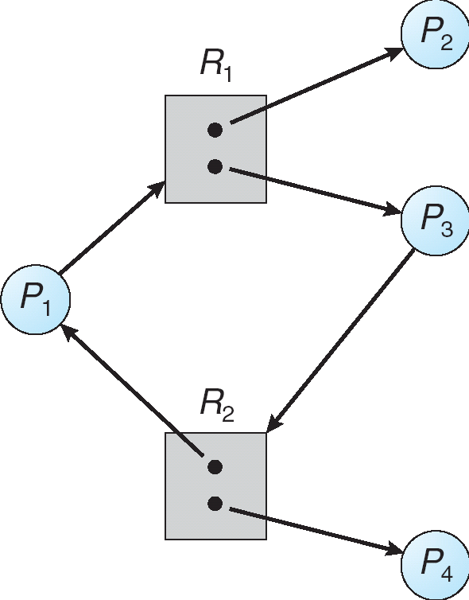
Graph with a cycle but no deadlock
Now consider the resource-allocation graph in Figure 7.4.
In this example,
we also have a cycle:
P1→R1→P3→R2→P1
However, there is no deadlock.
Observe that process P4 may release its instance of resource type R2.
That resource can then be allocated to P3, breaking the cycle.
In summary, if a resource-allocation graph does not have a cycle, then the system is not in a deadlocked state.
If there is a cycle, then the system may or may not be in a deadlocked state.
This observation is important when we deal with the deadlock problem.

Slide 19
Relationship of cycles to deadlocks
If a resource allocation graph contains no cycles ⇒ no deadlock
If a resource allocation graph contains a cycle and if only one instance exists per resource type ⇒ deadlock
If a resource allocation graph contains a cycle and and if several instances exists per resource type ⇒ possibility of deadlock

Slide 20
Que: Consider a system with four processes P1, P2, P3 and P4 and two resources, R1and R2 respectively.
Each resource has two instances. Furthermore:
• P1 allocates an instance of R2, and requests an instance of R1
• P2 allocates an instance of R1, and doesn’t need any other resource
• P3 allocates an instance of R1 and requires an instance of R2
• P4 allocates an instance of R2, and doesn’t need any other resource
Draw the resource allocation graph.
Is there a cycle in the graph? If yes name it.
P1 R1 P3 R2 P1

Slide 21
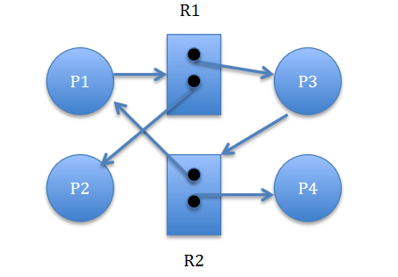
Solution:
Resource allocation graph

Slide 22
Que: A system has three types of resources R1 R2 R3 and their number of units are 3, 2, and 2 respectively. Four processes P1 P2 P3 and P4 are currently competing for these resources in following number.
i) P1 is holding one unit of R1 and is requesting for one unit of R2.
ii) P2 is holding two units of R2 and is requesting for one unit each of R1 and R3.
iii) P3 is holding one unit of R1 and is requesting for one unit of R2.
iv) P4 is holding two units of R3 and requesting for one unit of R1.
Draw the resource allocation graph for above. Determine if any of the processes are in deadlock state?

Slide 23
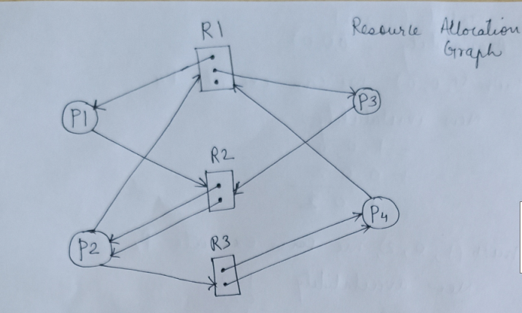
Solution:
Resource allocation graph

Slide 24
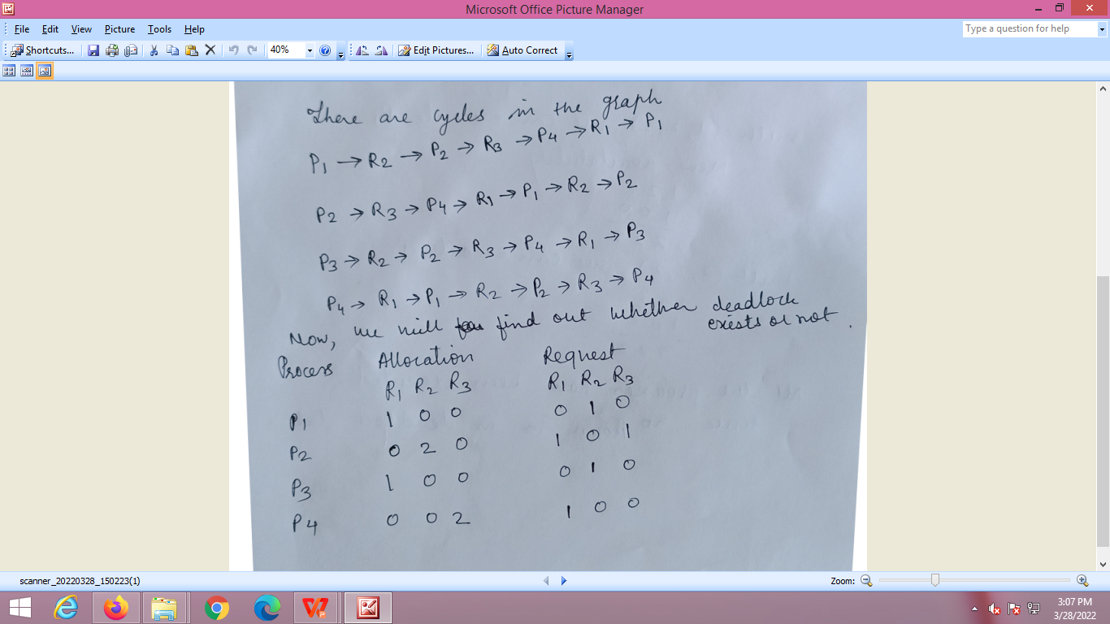
Cycle but no deadlock

Slide 25
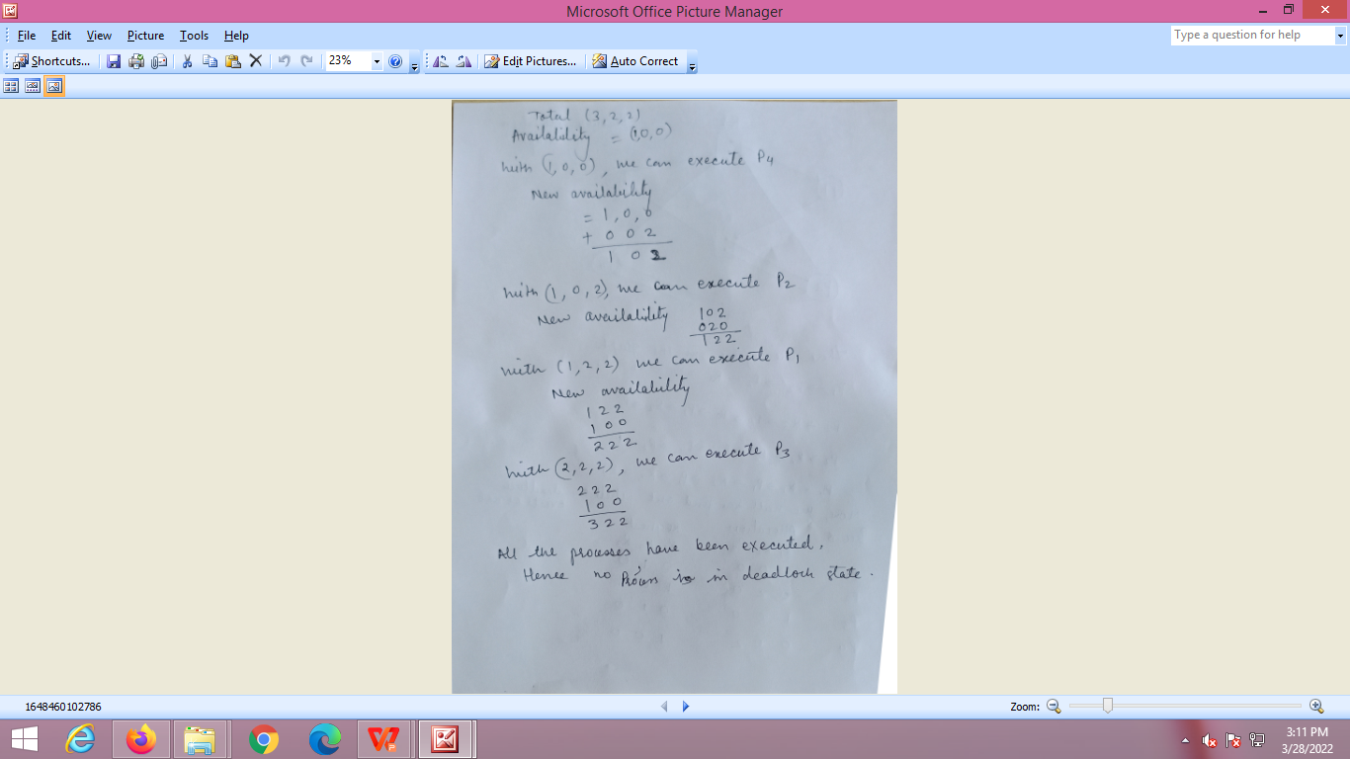
No processes are in deadlock state.

Slide 26
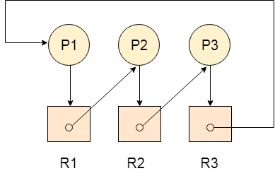
Que. The following example contains three processes P1, P2, P3 and three resources R1, R2, R3. All the resources are having single instances each.

Slide 27
Solution:
Allocation Matrix
Request Matrix
Process | R1 | R2 | R3
P1 | 0 | 0 | 1
P2 | 1 | 0 | 0
P3 | 0 | 1 | 0
Process | R1 | R2 | R3
P1 | 1 | 0 | 0
P2 | 0 | 1 | 0
P3 | 0 | 0 | 1
Avial = (0,0,0)
Neither we are having any resource available in the system nor a process going to release.
Each of the process needs at least single resource to complete therefore they will continuously be holding each one of them.
We cannot fulfill the demand of at least one process using the available resources therefore the system is deadlocked as determined earlier when we detected a cycle in the graph.

Slide 28
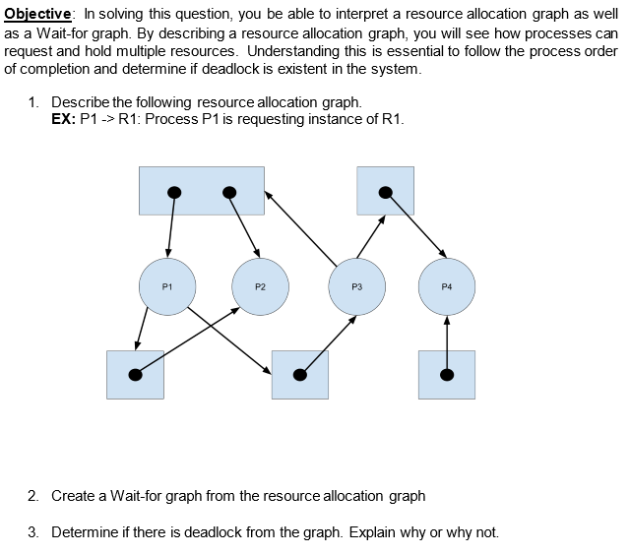
Determine if any of the processes are in deadlock state?

Slide 29
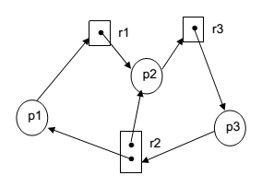
Determine if any of the processes are in deadlock state?

Slide 30
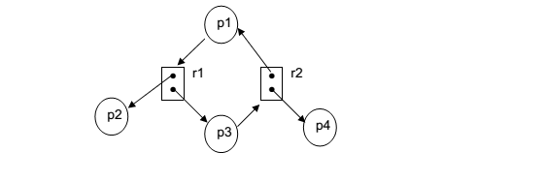
Determine if any of the processes are in deadlock state?

Slide 31
Methods for Handling Deadlocks
Use of protocol to prevent / Avoid deadlock
Ensure that the system will never enter a deadlock state
Detection & Recovery
Allow the system to enter a deadlock state and then recover
Do Nothing
Ignore the problem and pretend that deadlock never occur in a system.
and let the user or system administrator handle the problem; used by most operating systems, including Windows and UNIX

Slide 32
Deadlock Prevention
Avoid one of the necessary condition.
Mutual Exclusion –
The mutual-exclusion condition must hold for nonsharable resources.
For example, a printer cannot be simultaneously shared by several processes.
Sharable resources, in contrast, do not require mutually exclusive access and thus cannot be involved in a deadlock.
Read-only files are a good example of a sharable resource. If several processes attempt to open a read-only file at the same time, they can be granted simultaneous access to the file. A process never needs to wait for a sharable resource. In general, however, we cannot prevent deadlocks by denying the mutual-exclusion condition, because some resources are nonsharable.
Hold and Wait –
To ensure that the hold-and-wait condition never occurs in the system, we must guarantee that whenever a process requests a resource, it does not hold any other resources
Require a process to request and be allocated all its resources before it begins execution,
or allow a process to request resources only when the process has none
Example CD ROM – COPY ON DISK & sort -- PRINT
Result: Low resource utilization; starvation possible

Slide 33
Deadlock Prevention (Cont.)‏
No Preemption – (release & regain)
If a process that is holding some resources requests another resource that cannot be immediately allocated to it, then all resources currently being held are released
Preempted resources are added to the list of resources for which the process is waiting
A process will be restarted only when it can regain its old resources, as well as the new ones that it is requesting
A process is allowed to forcefully preempt the resources possessed by some other process only if-
It is a high priority process or a system process.
The victim process is in the waiting state.

Slide 34
Circular Wait-
The fourth and final condition for deadlocks is the circular-wait condition.
One way to ensure that this condition never holds is to impose a total ordering of all resource types and to require that each process requests resources in an increasing order of enumeration.
To illustrate, we let R = { R1, R2, ... , Rm} be the set of resource types.
We assign to each resource type a unique integer number, which allows us to compare two resources and to determine whether one precedes another in our ordering.
Formally, we define a one-to-one funtion F: R →N, where N is the set of natural numbers. For example, if the set of resource types R includes tape drives, disk drives, and printers, then the function F might be defined as follows:
F (tape drive) = 1
F (disk drive) = 5
F (printer) = 12

Slide 35
We can now consider the following protocol to prevent deadlocks:
Each process can request resources only in an increasing order of enumeration.
That is, a process can initially request any number of instances of a resource type -say, Ri. After that, the process can request instances of resource type Rj if and only if F(Rj) > F(Ri). For example, using the function defined previously, a process that wants to use the tape drive and printer at the same time must first request the tape drive and then request the printer. Alternatively, we can require that a process requesting an instance of resource type Rj must have released any resources Ri such that F(Ri) >=F(Rj). It must also be noted that if several instances of the same resource type are needed, a single request for all of them must be issued.
If these two protocols are used, then the circular-wait condition cannot hold.
Approach-
A natural number is assigned to every resource.
Each process is allowed to request for the resources either in only increasing or only decreasing order of the resource number.
In case increasing order is followed, if a process requires a lesser number resource, then it must release all the resources having larger number and vice versa.
This approach is the most practical approach and implementable.
However, this approach may cause starvation but will never lead to deadlock.

Slide 36
Deadlock Prevention Problems
Thus deadlock can be prevented by making one the required condition false.
By restricting process to access resource in particular order.
Problems
Low resource utilization
Reduced system throughput

Slide 37
Deadlock Avoidance
Requires that the system has some additional a priori information available.
Set of processes, Resources, Ordering of resources, request and release of resource of each process.
By using this information, for each request system identify whether there will be deadlock in future or not.
Different algorithms require different information.

Slide 38
Deadlock Avoidance
Simplest and most useful model requires that each process declare the maximum number of resources of each type that it may need
A Resource-Allocation state is defined by the number of available and allocated resources, and the maximum demands of the processes
The deadlock-avoidance algorithm dynamically examines the resource-allocation state to ensure that there can never be a circular-wait condition

Slide 39
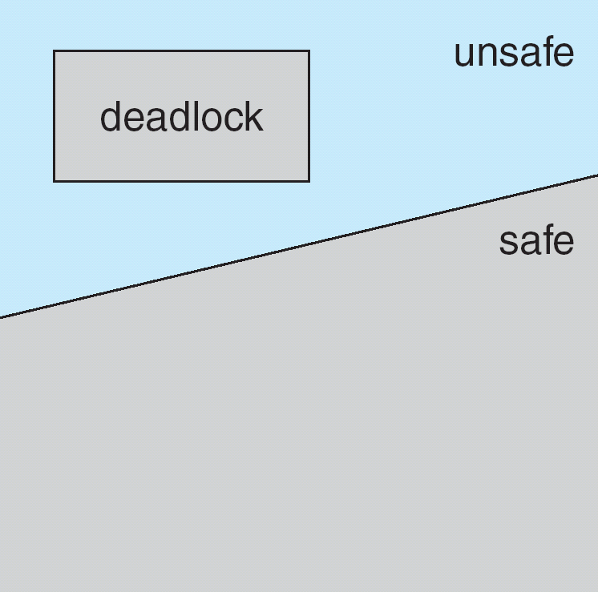
Safe, Unsafe , Deadlock State
Safe State:
All processes can
Complete the task.
Safe sequence
No deadlock
Unsafe State:
May lead to
Deadlock state
Deadlock Avoidance algorithm ensure that a system will never enter an unsafe state

Slide 40
Safe State (continued)‏
If a system is in safe state ⇒ no deadlocks
If a system is in unsafe state ⇒ possibility of deadlock
Avoidance ⇒ ensure that a system will never enter an unsafe state
When a process requests an available resource, the system must decide if immediate allocation leaves the system in a safe state
In safe state system can allocate resources to each process (upto its maximum) and still avoid deadlock.
Resources are allocated in a safe sequence.

Slide 41
Safe State
A sequence of processes <P₁, P₂, …, P_{n}> is a safe sequence for the current allocation state if, for each P_{i}, the resource requests that P_{i} can still make, can be satisfied by currently available resources plus resources held by all P_{j}, with j < i.
That is:
If the P_{i} resource needs are not immediately available, then P_{i} can wait until all P_{j} have finished
When P_{j} is finished, P_{i} can obtain needed resources, execute, return allocated resources, and terminate
When P_{i} terminates, P_{i +1} can obtain its needed resources, and so on
Number of Tape Drives = 12
Process | Maximum Need | Allocation | Current Need | Available
P0 | 10 | 5 | 5 | 3
P1 | 4 | 2 | 2
P2 | 9 | 2 | 7
Safe sequence: P1,P0,P2

Slide 42
Deadlock Avoidance algorithms
resource-allocation graph
For a single instance of each resource type.
Claim edge : process may request resource
Banker’s algorithm
For multiple instances of each resource type.

Slide 43
Resource-Allocation Graph Algorithm
If we have a resource-allocation system with only one instance of each resource type, we can use a variant of the resource-allocation graph. In addition to the request and assignment edges already described, we introduce a new type of edge, called a claim edge.
A claim edge Pi ->Rj indicates that process Pi may request resource Rj at some time in the future.
This edge resembles a request edge in direction but is represented in the graph by a dashed line.
When process Pi requests resource Rj, the claim edge Pi->Rj is converted to a request edge.
Similarly, when are source Rj is released by Pi, the assignment edge Rj ->Pi is reconverted to a claim edge Pi->Rj.
We note that the resources must be claimed a priori in the system. That is, before process Pi starts executing, all its claim edges must already appear in the resource-allocation graph.
We can relax this condition by allowing a claim edge Pi-> Rj to be added to the graph only if all the edges associated with process Pi are claim edges.
Now suppose that process Pi requests resource Rj.
The request can be granted only if converting the request edge Pi-> Rj to an assignment edge Rj ->Pi does not result in the formation of a cycle in the resource-allocation graph.
We check for safety by using a cycle-detection algorithm. If no cycle exists, then the allocation of the resource will leave the system in a safe state. If a cycle is found, then the allocation will put the system in an unsafe state. In that case, process Pi will have to wait for its requests to be satisfied.

Slide 44
Resource-Allocation Graph Algorithm
Summary:
Introduce a new kind of edge called a claim edge
Claim edge P_{i} R_{j} indicates that process P_{j} may request resource R_{j}; which is represented by a dashed line
A claim edge converts to a request edge when a process requests a resource
A request edge converts to an assignment edge when the resource is allocated to the process
When a resource is released by a process, an assignment edge reconverts to a claim edge
Resources must be claimed a priori in the system

Slide 45
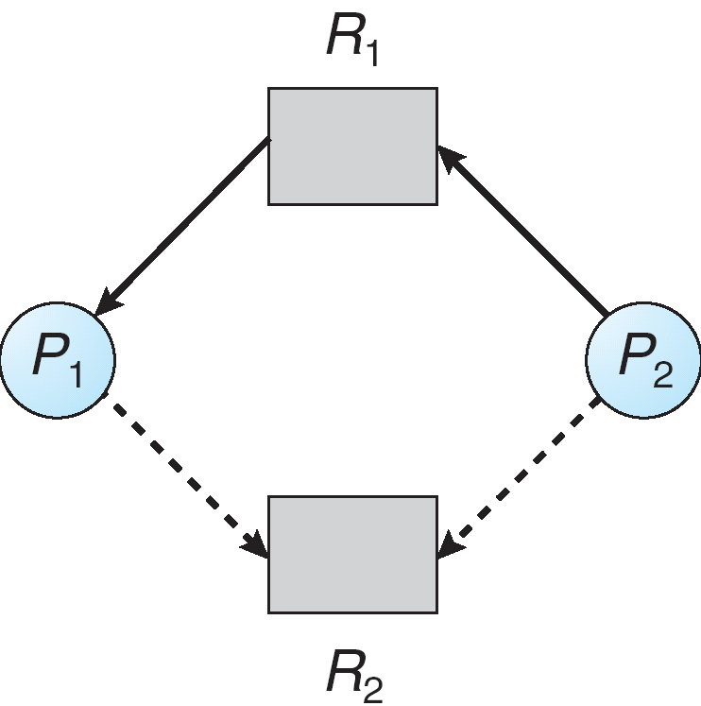
Resource-Allocation Graph Algorithm with Claim Edges cycle detection algorithm
Assignment
edge
Request
edge
Claim
edge
Claim
edge

Slide 46
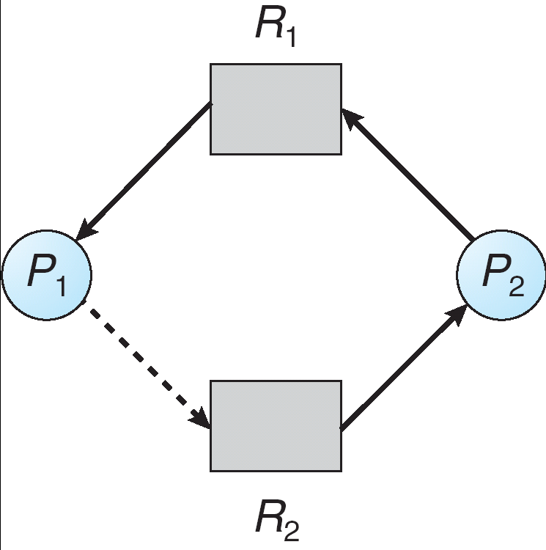
Unsafe State In Resource-Allocation Graph
Assignment
edge
Request
edge
Cycle?
State?
Deadlock?
Assignment
edge
Claim
edge

Slide 47
To illustrate this algorithm, we consider the resource-allocation graph of Figure 7.6. Suppose that P2 requests R2 . Although R2 is currently free, we cannot allocate it to P2, since this action will create a cycle in the graph (Figure 7.7). A cycle, as mentioned, indicates that the system is in an unsafe state. If P1 requests R2, and P2 requests R1, then a deadlock will occur.

Slide 48
Banker’s Algorithm

Slide 49
Banker’s Algorithm
Used when there exists multiple instances of a resource type
Each process must a priori claim maximum use
When a process requests a resource, it may have to wait
When a process gets all its resources, it must return them in a finite amount of time

Slide 50
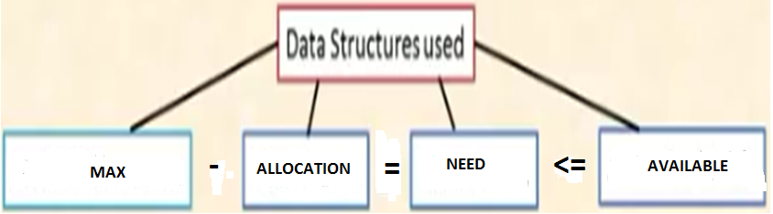
Data structures used

Slide 51
Data Structures for the Banker’s Algorithm
Let n = number of processes, and m = number of resources types.
Available: Vector of length m. If available [j] = k, there are k instances of resource type R_{j} available.
Max: n x m matrix. If Max [i,j] = k, then process P_{i} may request at most k instances of resource type R_{j}.
Allocation: n x m matrix. If Allocation[i,j] = k then P_{i} is currently allocated k instances of R_{j.}
Need: n x m matrix. If Need[i,j] = k, then P_{i} may need k more instances of R_{j} to complete its task.
Need [i,j] = Max[i,j] – Allocation [i,j]

Slide 52
1. Safety Algorithm
1. Let Work and Finish be vectors of length m and n respectively
Initialize Work=Available and Finish[i]=false for i=0,1,...n-1
2. Find an index i such that both
a. Finish[i]==false
b. Need[i]<=Work
if no such i exists, go to step 4.
3. Work = Work + Allocation[i]
Finish[i]=true
Goto step 2.
4. if Finish[i]==true for all i, then the system is in a safe
state.

Slide 53
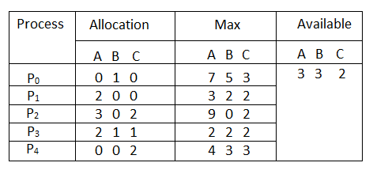
Considering a system with five processes P0 through P4 and three resources of type A, B, C. Resource type A has 10 instances, B has 5 instances and type C has 7 instances. Suppose at time t0 following snapshot of the system has been taken:
a.What will be the content of the Need matrix?
b.Is the system in a safe state? If Yes, then what is the safe sequence?

Slide 54
Example 1
A=10,B=5,C=7
Max Needs = allocated + need
process | Allocation |  |  |  | MAX |  |  |  | Need |  |  | <= | Available |  |  | T/F
 | A | B | C |  | A | B | C |  | A | B | C |  | A | B | C
P0 | 0 | 1 | 0 |  | 7 | 5 | 3 |  | 7 | 4 | 3 | <= | 3 | 3 | 2 | F
P1 | 2 | 0 | 0 |  | 3 | 2 | 2 |  | 1 | 2 | 2 | <= | 3 | 3 | 2 | T
P2 | 3 | 0 | 2 |  | 9 | 0 | 2 |  | 6 | 0 | 0 | <= | 5 | 3 | 2 | F
P3 | 2 | 1 | 1 |  | 2 | 2 | 2 |  | 0 | 1 | 1 | <= | 5 | 3 | 2 | T
P4 | 0 | 0 | 2 |  | 4 | 3 | 3 |  | 4 | 3 | 1 | <= | 7 | 4 | 3 | T
 |  |  |  |  |  |  |  |  |  |  |  |  | 7 | 4 | 5
<=745 T
<=755 T
10 5 7
IS THE SYSTEM IN SAFE STATE?
If Need <= Available…….then new available
P0)743<=332….False… new available= 332
P1)122<=332….True… new available= 332+200=532
P2)600<=532…False… new available=532
P3)011<=532…True…new available=532+211=743
P4)431<=743…True…new available=743+002=745
P2)600<=745…True…new available=745+302=10 4 7
P0)743<=10 4 7…True…new available=10 4 7 + 010=10 5 7
Process sequence is P1,p3,p4,p2,P0
1)Identify Need Matrix
2)is the system in safe state?

Slide 55
Problem with deadlock avoidance algorithm
Overhead of maintaining entire information

Slide 56
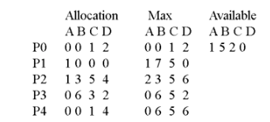
Example 2
a.What will be the content of the Need matrix?
b.Is the system in a safe state? If Yes, then what is the safe sequence?

Slide 57
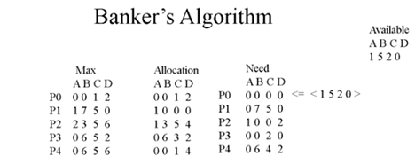

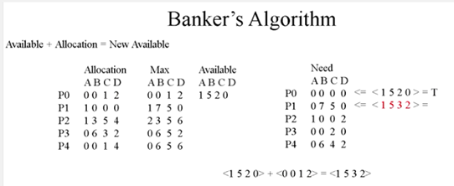

Slide 58
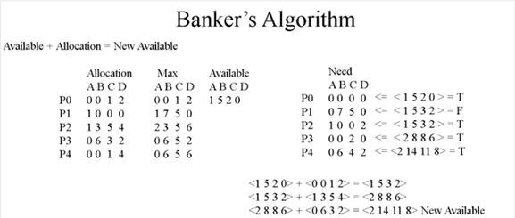
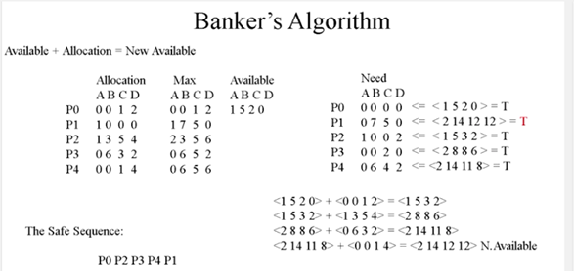
If there is additional request of P1 for (102) can the request granted immediately?

Slide 59
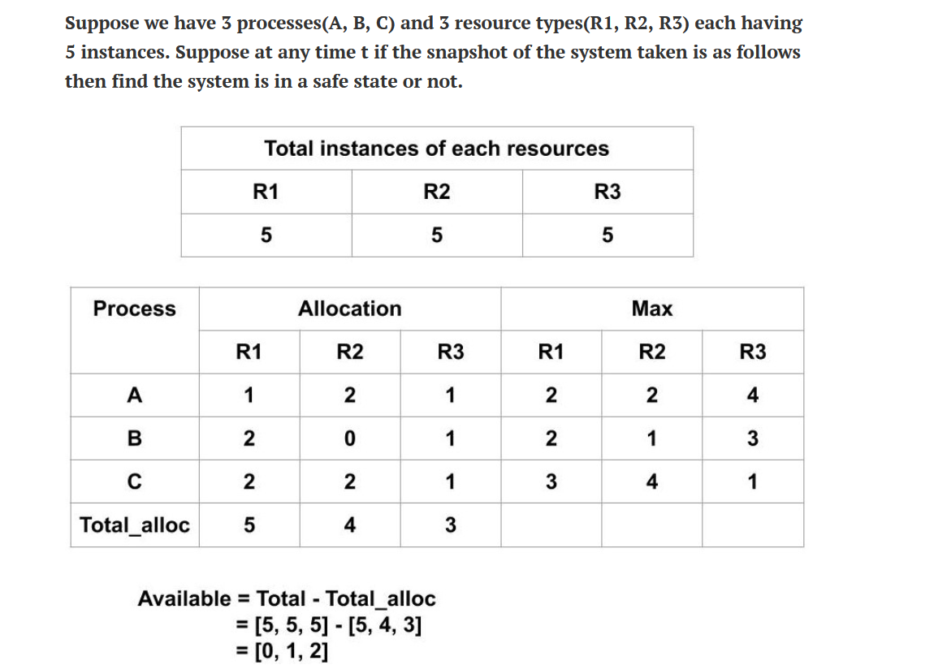
Q1
a.What will be the content of the Need matrix?
b.Is the system in a safe state? If Yes, then what is the safe sequence?

Slide 60
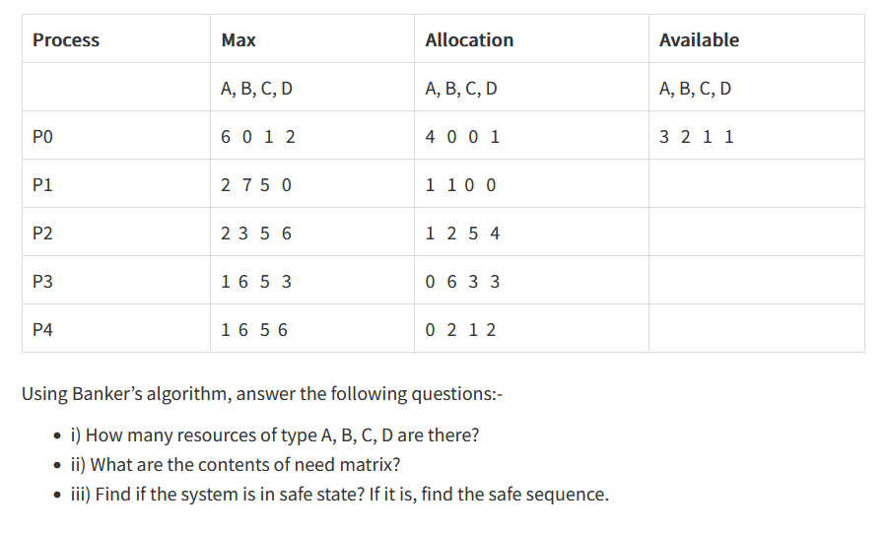
Q2
a.What will be the content of the Need matrix?
b.Is the system in a safe state? If Yes, then what is the safe sequence?

Slide 61
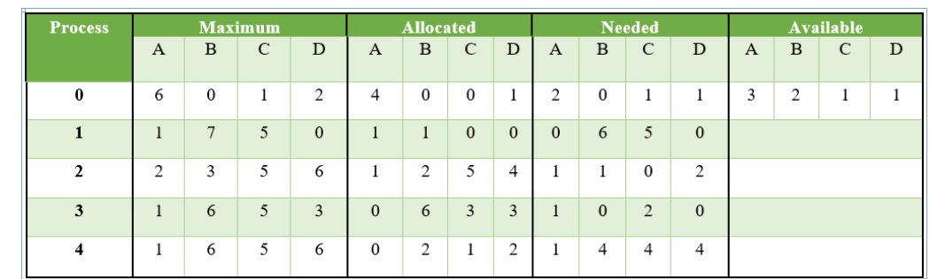
a.What will be the content of the Need matrix?
b.Is the system in a safe state? If Yes, then what is the safe sequence?

Slide 62
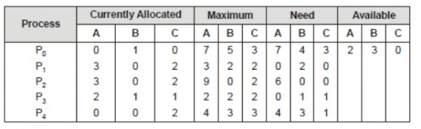
Consider the following system snapshot
a.What will be the content of the Need matrix?
b.Is the system in a safe state? If Yes, then what is the safe sequence?

Slide 63
Deadlock Detection

Slide 64
Deadlock Detection and Recovery
If we fail to employ preventive measures for deadlock prevention or avoidance, deadlock may occur.
System periodically invokes the deadlock detection algorithm.
If algorithm detects deadlock, it executes recovery algorithm.
But data loss can be there during recovery.
This algorithm can be used for single as well as multiple instances.

Slide 65
Deadlock Detection
For deadlock detection, the system must provide
An algorithm that examines the state of the system to detect whether a deadlock has occurred
And an algorithm to recover from the deadlock
A detection-and-recovery scheme requires various kinds of overhead
Run-time costs of maintaining necessary information and executing the detection algorithm
Potential losses inherent in recovering from a deadlock

Slide 66
Single Instance of Each Resource Type
Requires the creation and maintenance of a wait-for graph
Consists of a variant of the resource-allocation graph
The graph is obtained by removing the resource nodes from a resource-allocation graph and collapsing the appropriate edges
Consequently; all nodes are processes
P_{i} → P_{j} if P_{i} is waiting for P_{j}.
Periodically invoke an algorithm that searches for a cycle in the graph
If there is a cycle, there exists a deadlock
An algorithm to detect a cycle in a graph requires an order of n² operations, where n is the number of vertices in the graph

Slide 67
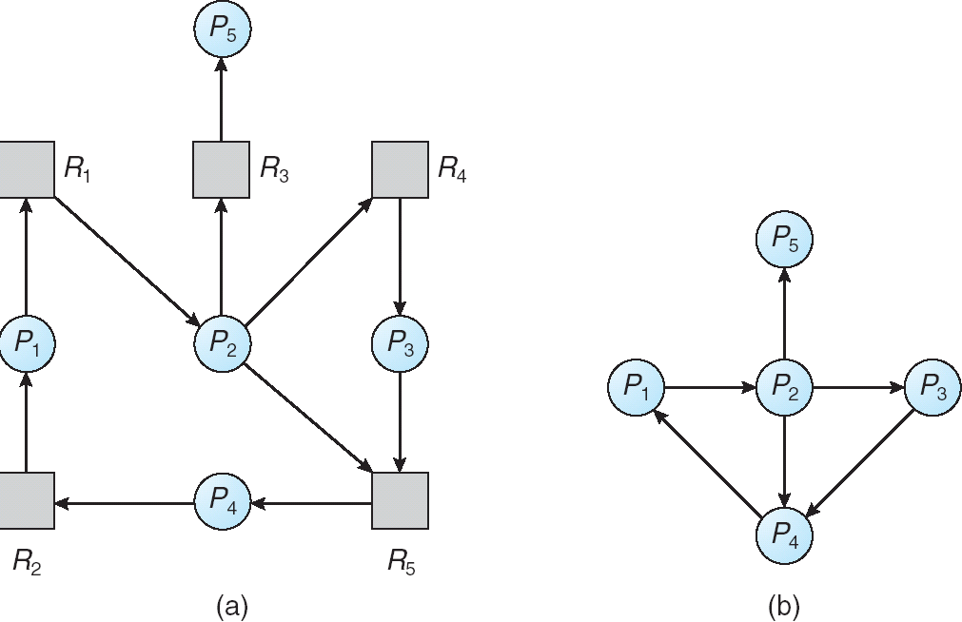
Resource-Allocation Graph and Wait-for Graph
Resource-Allocation Graph
Corresponding wait-for graph

Slide 68
Multiple Instances of a Resource Type
Required data structures:
Available: A vector of length m indicates the number of available resources of each type.
Allocation: An n x m matrix defines the number of resources of each type currently allocated to each process.
Request: An n x m matrix indicates the current request of each process. If Request [i_{j}] = k, then process P_{i} is requesting k more instances of resource type. R_{j}.

Slide 69
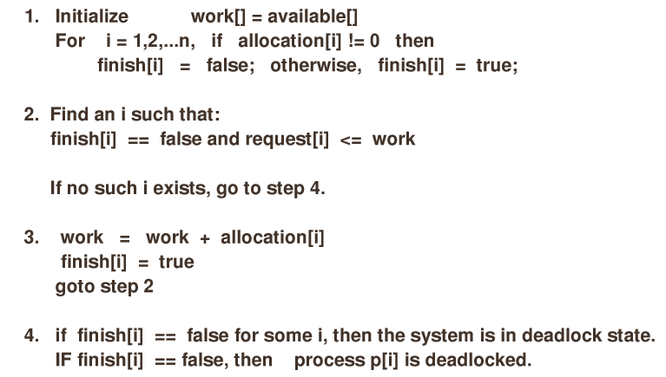
Deadlock detection

Slide 70
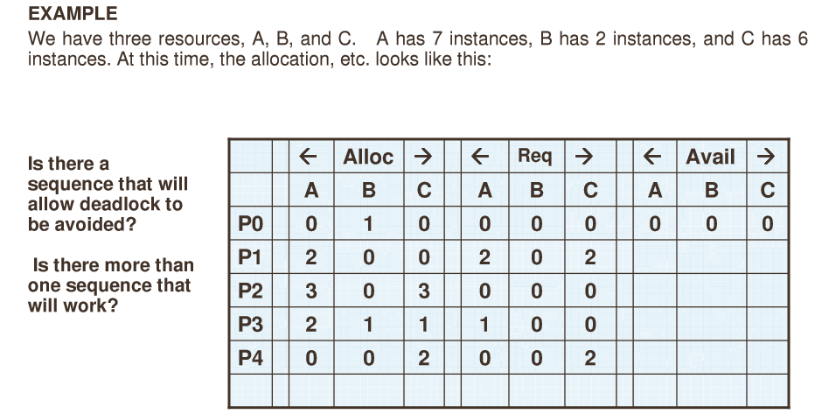
Deadlock detection
7 2 6
After execution of algorithm it is found that
P0,P2,P3,P4,P1 results in Finish[i]==true for all i So system is not in deadlock state

Slide 71
Deadlock detection contd....
Suppose P2 makes one additional request for C , can system in deadlock state?
Then the state will be as follows:
Request
P0 | 0 | 0 | 0
P1 | 2 | 0 | 2
P2 | 0 | 0 | 1
P3 | 1 | 0 | 0
P4 | 0 | 0 | 2
system will be in deadlock state
Although we claim the resources held by P0,
Number of resources available is not sufficient
To fulfil the request of other processes.
Deadlock exists, consisting of processes P1,P2,P3,P4.

Slide 72
Detection-Algorithm Usage
When, and how often, to invoke the detection algorithm depends on: (frequency / resources not available / cpu usage fall below 40%)
How often is a deadlock likely to occur?
How many processes will be affected by deadlock when it happens?
If the detection algorithm is invoked arbitrarily, there may be many cycles in the resource graph and so we would not be able to tell which one of the many deadlocked processes “caused” the deadlock
If the detection algorithm is invoked for every resource request, such an action will incur a considerable overhead in computation time
A less expensive alternative is to invoke the algorithm when CPU utilization drops below 40%, for example
This is based on the observation that a deadlock eventually cripples system throughput and causes CPU utilization to drop

Slide 73
Recovery From Deadlock

Slide 74
Recovery from Deadlock
Two Approaches
Thereare two options for breaking a deadlock One is simply to abort one or more processes to break the circular wait. The other is to preempt some resources from one or more of the deadlocked processes.
Process termination by Abort all or each process
Resource preemption

Slide 75
Recovery from Deadlock: Process Termination
Abort all deadlocked processes
This approach will break the deadlock, but at great expense
Abort one process at a time until the deadlock cycle is eliminated
This approach incurs considerable overhead, since, after each process is aborted, a deadlock-detection algorithm must be re-invoked to determine whether any processes are still deadlocked
Many factors may affect which process is chosen for termination
What is the priority of the process?
How long has the process run so far and how much longer will the process need to run before completing its task?
How many and what type of resources has the process used?
How many more resources does the process need in order to finish its task?
How many processes will need to be terminated?
Is the process interactive or batch?

Slide 76
Recovery from Deadlock: Resource Preemption
With this approach, we successively preempt some resources from processes and give these resources to other processes until the deadlock cycle is broken
When preemption is required to deal with deadlocks, then three issues need to be addressed:
Selecting a victim – Which resources and which processes are to be preempted?
As in process termination, we must determine the order of preemption to minimize cost. Cost factors may include such parameters as the number of resources a deadlocked process is holding and the amount of time the process has thus far consumed during its execution.
Rollback – If we preempt a resource from a process, what should be done with that process?
Rollback the process to safe state and restart from that state.
Starvation – How do we ensure that starvation will not occur? That is, how can we guarantee that resources will not always be preempted from the same process?

